Slide 1
Unit-2 (4 hrs)
The InetAddress Class:Creating new InetAddress Objects, Getter methods
Address Types, Testing Reachability and object Method
Inet4Address and Inet6Address
The Network Interface Class: Factory Method and Getter Method
Some useful Programs: SpamCheck, Processing web Server Logfiles

Slide 2
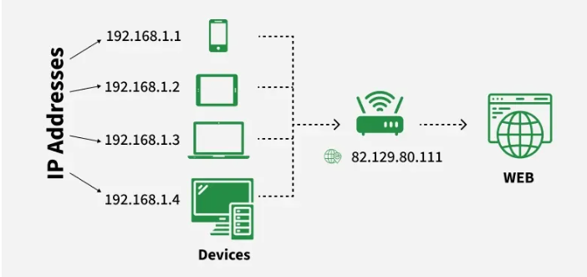
IP Address
An IP Address (Internet Protocol Address) is a unique numerical label assigned to each device connected to a computer network that uses the Internet Protocol for communication. It serves two main purposes:
1). Identifying a device on the network.
2). Locating the device to enable communication with other devices over a network like the Internet.

Slide 3
Most Network Combine ip with TCP(Transmission Control Protocol) it builds a virtual bridge among the destination and the source.
two version of ip Address
1). IPv4 :
2). IPv6

Slide 4
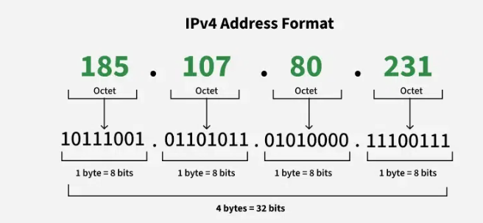
IPv4
An IPv4 address consists of series of four eight-bit binary numbers which are separated by decimal point. Although any numbering system can be used to represent a unique 32- bit number, most commonly you see IP address expressed in dot decimal notation.
An IPv4 address is normally written as four unsigned bytes, each ranging from 0 to 255,with the most significant byte first. Bytes are separated by periods for the convenience of human eyes. For example, the address for login.ibiblio.org is 152.19.134.132. This is called the dotted quad format.

Slide 5
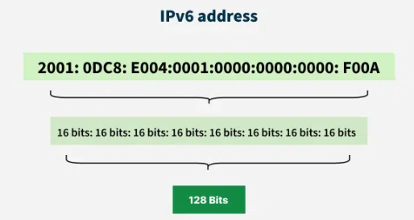
IPv6
IPv6 is the newest version of the Internet Protocol (IP) — the system used to identify and locate devices on a network and route traffic across the internet. It was developed to replace IPv4, which is running out of unique addresses.
IPv4 uses 32-bit addresses, allowing around 4.3 billion unique IP addresses. With the growth of the internet, connected devices (phones, IoT, computers, etc.) have increased dramatically — so IPv4 addresses became insufficient. IPv6 solves this problem with a much larger address space.
IPv6 uses 128-bit addresses, allowing approximately 340 undecillion (3.4 × 10³⁸) unique addresses.

Slide 6
InetAddress Class
The java.net.InetAddress class is Java’s high-level representation of an IP address, both IPv4 and IPv6. It is used by most of the other networking classes, including Socket, ServerSocket, URL, DatagramSocket, DatagramPacket, and more. Usually, it includes both a hostname and an IP address.

Slide 7
Creating New InetAddress Objects
There are no public constructors in the InetAddress class. Instead, InetAddress has static factory methods that connect to a DNS server to resolve a hostname. The most common is InetAddress.getByName(). For example, this is how you look up www.oreilly.com:
InetAddress address = InetAddress.getByName("www.oreilly.com");
This method does not merely set a private String field in the InetAddress class. It actually makes a connection to the local DNS server to look up the name and the numeric address

Slide 8
Getter Methods
The InetAddress class contains four getter methods that return the hostname as a string and the IP address as both a string and a byte array:
public String getHostName()
public String getCanonicalHostName()
public byte[] getAddress()
public String getHostAddress()

Slide 9
The getHostName() method returns a String that contains the name of the host with the IP address represented by this InetAddress object.
for example:
InetAddress machine = InetAddress.getLocalHost();
String localhost = machine.getHostName();
The getCanonicalHostName() method is similar, but it’s a bit more aggressive about contacting DNS. getHostName() will only call DNS if it doesn’t think it already knows the hostname. getCanonicalHostName() calls DNS if it can, and may replace the existing cached hostname. For example:
InetAddress machine = InetAddress.getLocalHost();
String localhost = machine.getCanonicalHostName();
The getCanonicalHostName() method is particularly useful when you’re starting with a dotted quad IP address rather than the hostname. folliwing example converts the dotted quad address 208.201.239.37 into a hostname by using InetAddress.getByName() and then applying getCanonicalHostName() on the resulting object.
InetAddress ia = InetAddress.getByName("208.201.239.100");
System.out.println(ia.getCanonicalHostName());

Slide 10
The getHostAddress() method returns a string containing the dotted quad format of the IP address.
InetAddress me = InetAddress.getLocalHost();
String dottedQuad = me.getHostAddress();
System.out.println("My address is " + dottedQuad);
If you want to know the IP address of a machine (and you rarely do), then use the getAddress() method, which returns an IP address as an array of bytes in network byte order. The most significant byte (i.e., the first byte in the address’s dotted quad form) is the first byte in the array, or element zero. To be ready for IPv6 addresses, try not to assume anything about the length of this array. If you need to know the length of the array, use the array’s length field:
InetAddress me = InetAddress.getLocalHost();
byte[] address = me.getAddress();

Slide 11
Address Types
Some IP addresses and some patterns of addresses have special meanings. For instance, I’ve already mentioned that 127.0.0.1 is the local loopback address. IPv4 addresses in the range 224.0.0.0 to 239.255.255.255 are multicast addresses that send to several subscribed hosts at once. Java includes 10 methods for testing whether an InetAddress object meets any of these criteria:
public boolean isAnyLocalAddress()
public boolean isLoopbackAddress()
public boolean isLinkLocalAddress()
public boolean isSiteLocalAddress()
public boolean isMulticastAddress()
a). public boolean isMCGlobal()
b). public boolean isMCNodeLocal()
c). public boolean isMCLinkLocal()
d). public boolean isMCSiteLocal()
e). public boolean isMCOrgLocal()

Slide 12
The isAnyLocalAddress() method returns true if the address is a wildcard address, false otherwise. A wildcard address matches any address of the local system. This is important if the system has multiple network interfaces, as might be the case on a system with multiple Ethernet cards or an Ethernet card and an 802.11 WiFi nterface. In IPv4, the wildcard address is 0.0.0.0. In IPv6, this address is 0:0:0:0:0:0:0:0 (a.k.a. ::).
The isLoopbackAddress() method is used to check if an IP address is a loopback address. Loopback addresses (127.0.0.1 for IPv4 and ::1 for IPv6) refer to the local machine.
The isLinkLocalAddress() method returns true if the address is an IPv6 link-local address, false otherwise. This is an address used to help IPv6 networks self-configure, much like DHCP on IPv4 networks but without necessarily using a server. Routers do not forward packets addressed to a link-local address beyond the local subnet. All link_x0002_local addresses begin with the eight bytes FE80:0000:0000:0000. The next eight bytes are filled with a local address, often copied from the Ethernet MAC address assigned by the Ethernet card manufacturer.
The isSiteLocalAddress() method returns true if the address is an IPv6 site-local address, false otherwise. Site-local addresses begin with the eight bytes FEC0:0000:0000:0000. The next eight bytes are filled with a local address, often copied from the Ethernet MAC address assigned by the Ethernet card manufacturer.

Slide 13
The isMulticastAddress() method returns true if the address is a multicast address, false otherwise. Multicasting broadcasts content to all subscribed computers rather than to one particular computer. In IPv4, multicast addresses all fall in the range 224.0.0.0 to 239.255.255.255. In IPv6, they all begin with byte FF.
isMCGlobal Method checks whether an IP address is a globally scoped multicast address, meaning it is intended for global communication across the internet. Useful for applications like live streaming, real-time data distribution, and distributed computing. In IPv4 it ranges from 224.0.1.0 to 238.255.255.255 and in IPv6 it starting with ff0e::/16
The isMCOrgLocal() method returns true if the address is an organization-wide multicast address, false otherwise. An organization-wide multicast address may have subscribers within all the sites of a company or organization, but not outside that organization.
The isMCSiteLocal() method returns true if the address is a site-wide multicast address, false otherwise. Packets addressed to a site-wide address will only be transmitted within their local site. Site-wide multicast addresses begin with FF05 or FF15, depending on whether the multicast address is a well known permanently assigned address or a transient address.
isMCNodeLocal(): It checks whether an IP address is a node-local multicast address, meaning it is restricted to a single device (node) and is not forwarded beyond the local interface. Useful for inter-process communication (IPC) within a device. IPv4 does not support node-local multicast, so this method only applies to IPv6 it starting with ff01::/16.

Slide 14
isMCLinkLocal(): It checks whether an IP address is a link-local multicast address, meaning it is restricted to the local network segment (link) and is not forwarded beyond it. In IPv4, link local multicast addresses are in the range 224.0.0.0 to 224.0.0.255. In IPv6, link-local multicast addresses are in the range ff02::/16. This method is useful for network programming, especially when you need to handle multicast communication within the local network.

